Slide 1
PROJECT TITLE : Secure Data Hiding In image using steganography
CAPSTONE PROJECT
Presented By:
Student Name : Rahul Chaudhary
College Name & Department : Delhi Skill And Entrepreneurship University ( CSE Department )

Slide 2
OUTLINE
Problem Statement
Technology used
Wow factor
End users
Result
Conclusion
Git-hub Link
Future scope

Slide 3
Problem Statement
In the digital age, securing sensitive information is a critical challenge. Traditional encryption methods ensure
data confidentiality but may attract attention . Steganography offers a covert approach by embedding secret
messages within digital images, making detection difficult. This project focuses on developing a secure and
efficient steganographic system that allows users to hide and retrieve confidential data from images using
encryption and a password-based authentication mechanism.

Slide 4
Technology used
Python – The core programming language for implementing steganography.
OpenCV (cv2) – Used for image processing and manipulation.
Tkinter – For creating a graphical user interface (GUI) to interact with the system.
NumPy – Used for handling image arrays and pixel modifications efficiently.
OS Module – For file handling operations like opening and saving images.

Slide 5
Wow factors
Efficient Pixel-Level Encoding – The message is embedded at the pixel level, making it nearly undetectable while maintaining image quality.
Password-Protected Steganography – Unlike basic steganographic tools, this project adds an extra layer of security with password authentication before decryption.
User-Friendly GUI – A well-designed graphical user interface (GUI) using Tkinter makes it easy for users to hide and retrieve messages without technical knowledge.
Efficient Pixel-Level Encoding – The message is embedded at the pixel level, making it nearly undetectable while maintaining image quality.
Cross-Platform Compatibility – The project runs on multiple operating systems, including Windows and Linux, without requiring heavy dependencies.
Real-Time Encryption & Decryption – The system ensures fast and secure message hiding and extraction with minimal processing time.
Dynamic Message Length Support – The algorithm adapts to varying message lengths, allowing flexible data hiding without corrupting the image.

Slide 6
End users
Cybersecurity Professionals – To securely communicate sensitive information without attracting attention.
Journalists & Whistleblowers – To transmit confidential data safely in restricted environments.
Government & Defense Agencies – For secure data exchange and covert communication.
Corporate Organizations – To protect intellectual property and internal communications.
General Users – Individuals who want to send private messages securely without encryption tools.
Forensic Experts – To analyze and detect hidden messages in digital images.
This project benefits anyone needing secure and undetectable data transmission using image steganography.

Slide 7
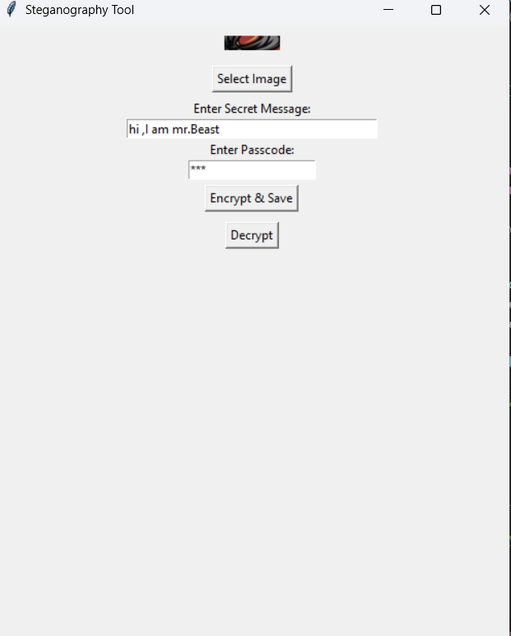
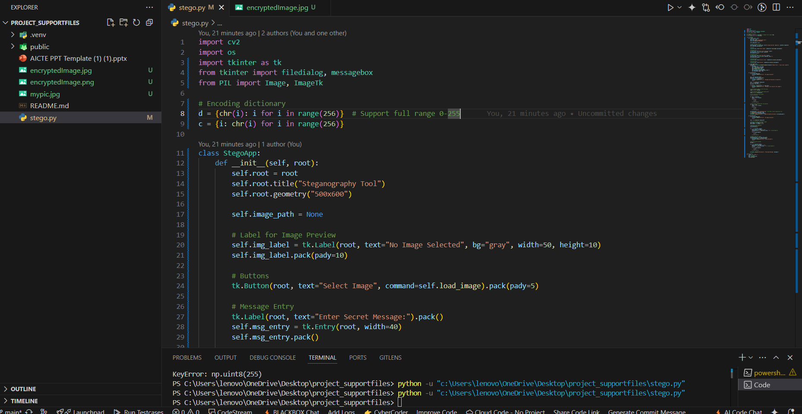
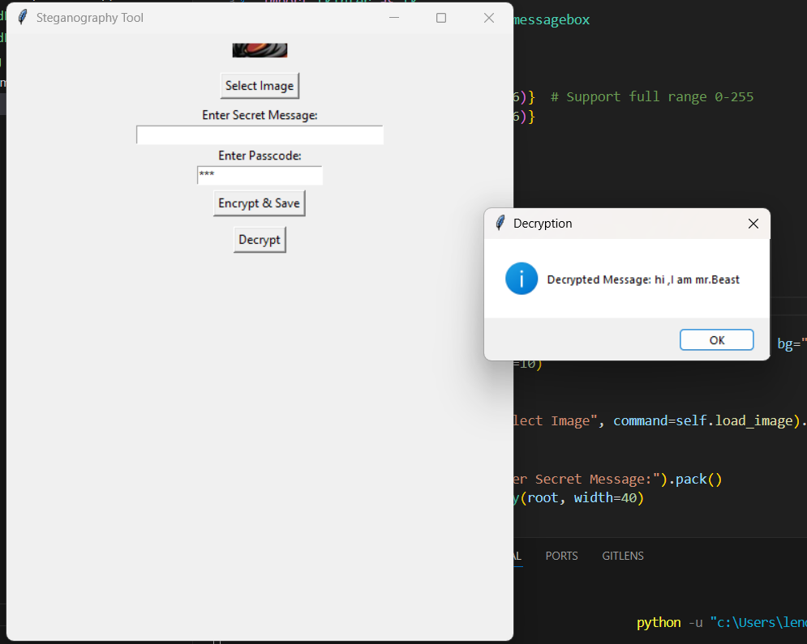
Results

Slide 8
Conclusion
The "Secure Data Hiding in Images Using Steganography" project successfully demonstrates a robust and efficient method for concealing sensitive information within digital images. By integrating password protection, pixel-level encoding, and a user-friendly GUI, the system ensures secure and undetectable data transmission. The use of OpenCV, Tkinter, and NumPy enhances performance and accessibility, making it suitable for various applications, including cybersecurity, government communication, and personal data protection.
This project highlights the power of steganography in modern digital security and provides a practical, secure, and easy-to-use solution for covert communication. Future enhancements could include advanced encryption techniques, AI-based steganalysis prevention, and support for multiple file formats to further strengthen security. 🚀🔐

Slide 9
GitHub Link
GitHub Link :https://github.com/Rahulchaudharyji2/Secure-Data-Hiding-In-image-using-steganography.git

Slide 10
Future scope(optional)
Enhanced Security Mechanisms
Implementing AES or RSA encryption along with steganography for added security.
Multi-layer encryption to prevent unauthorized decryption.
Improved Image Processing Techniques
Using deep learning for intelligent data embedding.
Enhancing pixel manipulation for better concealment without noticeable distortion.
Cross-Platform Accessibility
Developing a mobile application (Android/iOS) for easy encryption and decryption.
Web-based steganography tool for online secure communication.
Integration with Blockchain
Using blockchain technology to verify and track secure transmissions.
Ensuring authenticity and preventing unauthorized modifications.
Support for Multiple Media Formats
Extending the project to video, audio, and document file formats.
Developing real-time steganography for video streaming.
AI-Powered Detection and Prevention
AI-driven steganalysis to identify potential hidden data threats.
Implementing machine learning models for anomaly detection in images.

Slide 11
THANK YOU

